Slide 1

E - BUSINESS ANALYZE
SQL PROJECT

Slide 2

OBJECTIVE
RDBMS USED TO RUN THE QUERIES : MYSQL
The primary objective of the E-business is
To achieve sustainable business growth while addressing existing challenges.
We need to examine the dataset with SQL and help the E-business understand its business growth by answering simple question.

Slide 3

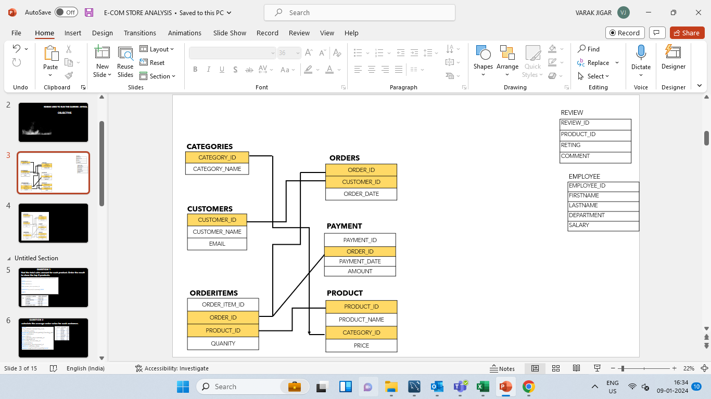

E-BUSINESS DATABASE SCHEMA

Slide 4


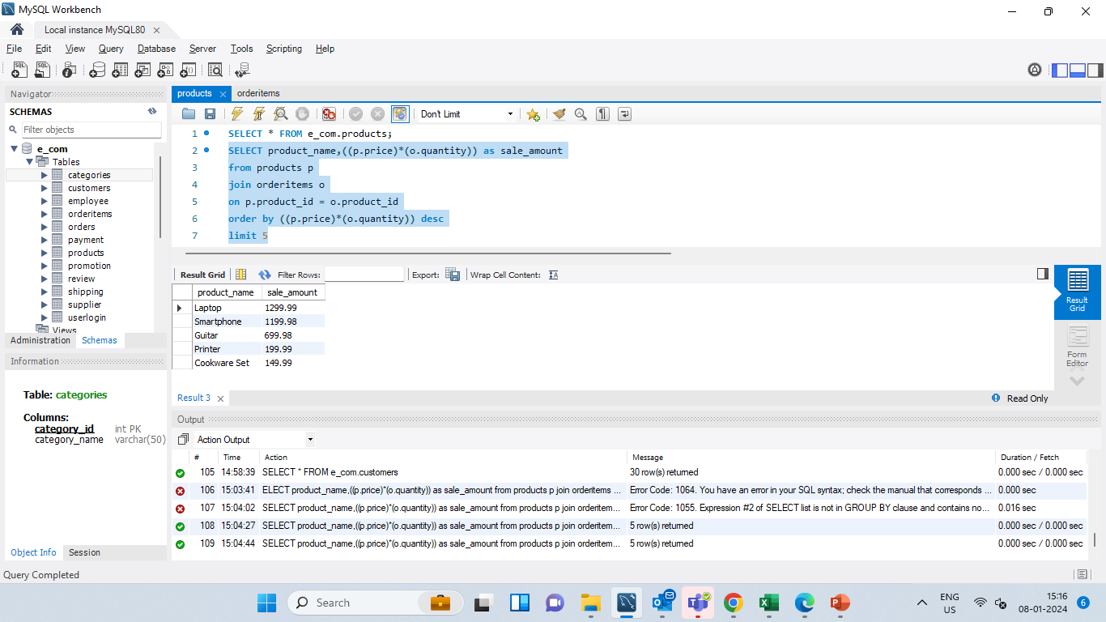
QUESTION 1
find the total sales amount for each product. Order the result to show the top 5 products.
SELECT product_name,((p.price)*(o.quantity)) as sale_amount
FROM products p
JOIN orderitems o
ON p.product_id = o.product_id
ORDER BY ((p.price)*(o.quantity)) DESC
LIMIT 5;

Slide 5
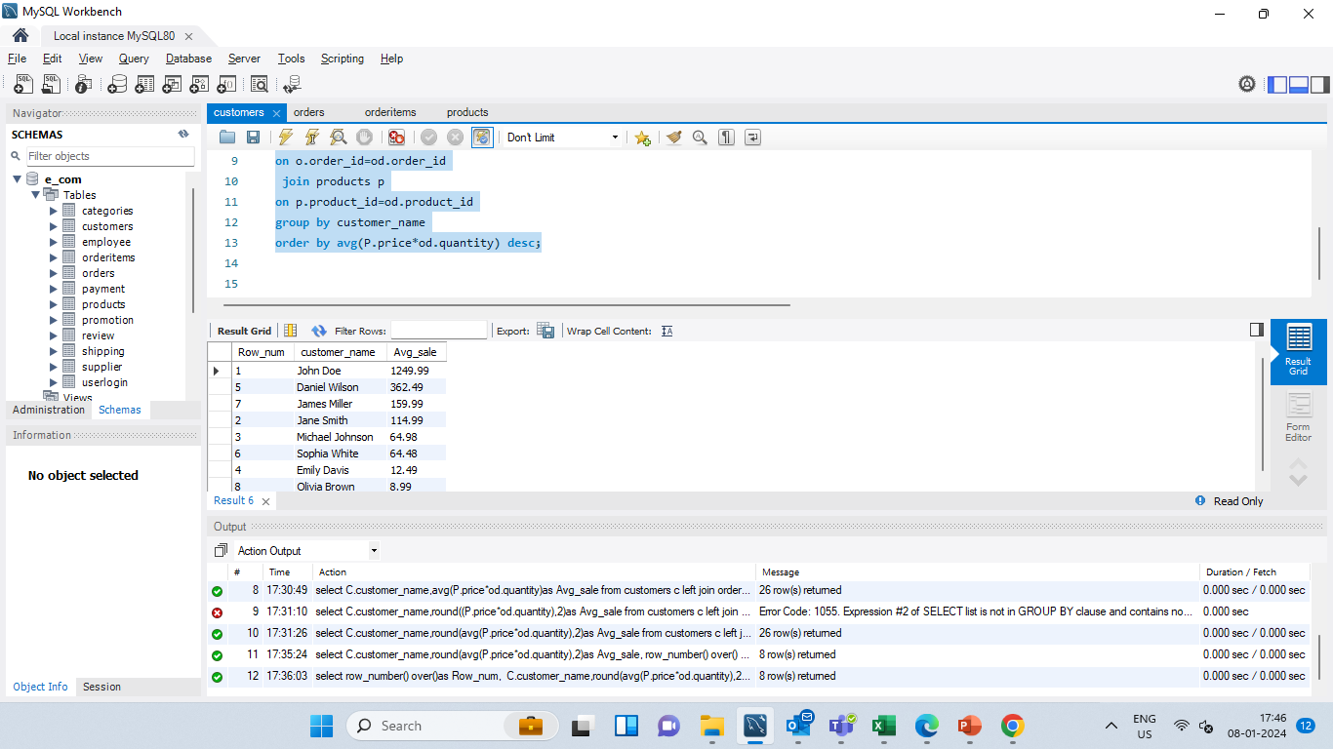

QUESTION 2
calculate the average order value for each customer.
SELECT
row_number() over()as Row_num, C.customer_name,
ROUND(AVG(P.price*od.quantity),2) as Avg_sale
FROM customers c
JOIN orders o
ON c.customer_id=o.customer_id
JOIN orderitems od
ON o.order_id=od.order_id
JOIN products p
ON p.product_id=od.product_id
GROUP BY customer_name
ORDER BY avg(P.price*od.quantity) DESC;

Slide 6

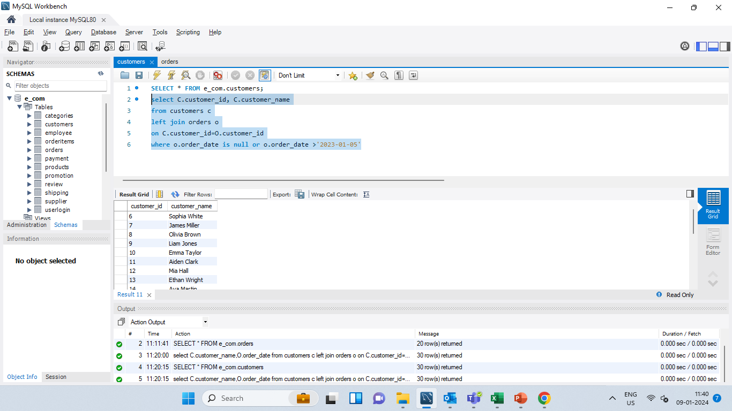
QUESTION 3
identify customers who have not placed any orders in the after ‘2023-01-05’.
SELECT
C.customer_id,
C.customer_name
FROM customers c
LEFT JOIN orders o
ON C.customer_id=O.customer_id
WHERE o.order_date IS NULL OR o.order_date >'2023-01-05'

Slide 7

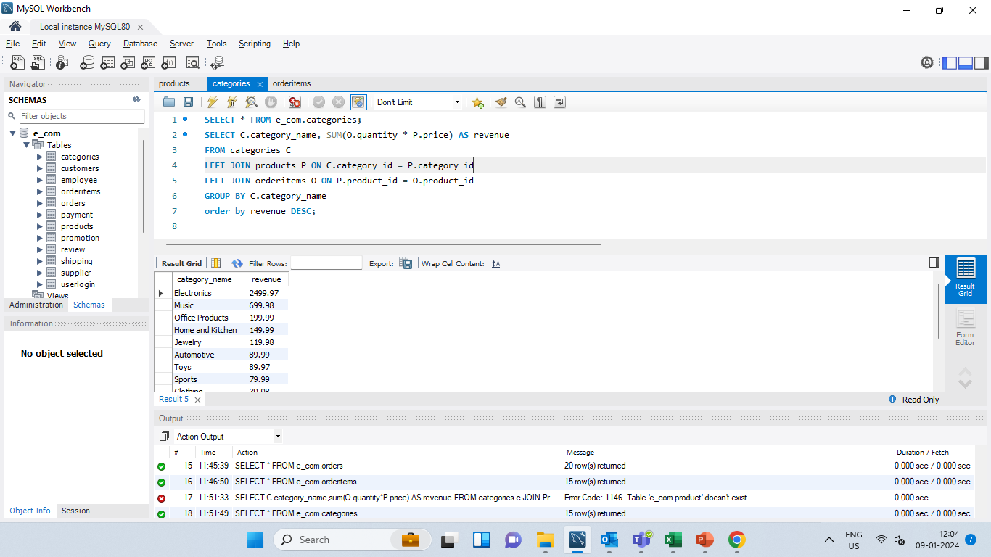
QUESTION 4
Total revenue for each product category.
SELECT
C.category_name,
SUM(O.quantity * P.price) AS revenue
FROM categories C
LEFT JOIN products P
ON C.category_id = P.category_id
LEFT JOIN orderitems O
ON P.product_id = O.product_id
GROUP BY C.category_name
ORDER BY revenue DESC;

Slide 8
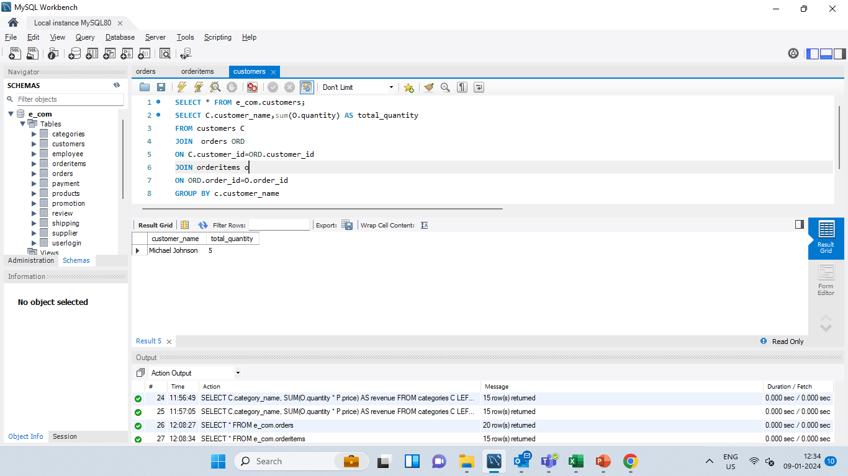
Find employees who have processed the highest number of orders.
QUSTION 5
SELECT
C.customer_name,
SUM(O.quantity) AS total_quantity
FROM customers C
JOIN orders ord
ON C.customer_id=ord.customer_id
JOIN orderitems o
ON ord.order_id=O.order_id
GROUP BY c.customer_name
ORDER BY total_quantity DESC
LIMIT 1;

Slide 9
QUESTION 6
Retrieve the latest order details for each customer:
WITH RankedOrders AS (
SELECT Customer_ID, Order_ID, Order_Date,
ROW_NUMBER() OVER (PARTITION BY Customer_ID ORDER BY Order_Date DESC) AS RowNum FROM Orders
)
SELECT R.Order_ID, C.customer_name,products.product_name,orderitems.quantity, R.Order_Date FROM RankedOrders R
JOIN customers c ON R.customer_id=C.customer_id
JOIN orders ON orders.customer_id=C.customer_id
JOIN orderitems ON orders.order_id=orderitems.order_id
JOIN products ON orderitems.product_id=products.product_id
WHERE RowNum = 1;

Slide 10
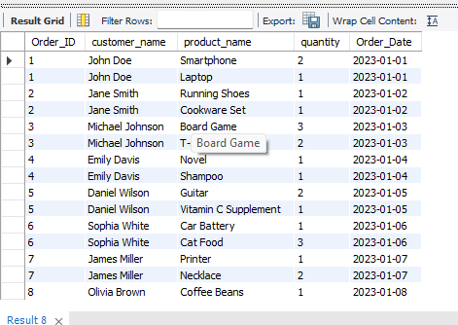
QUESTION 6
Retrieve the latest order details for each customer:
OUTPUT

Slide 11
Write a query to find the top 3 customers who spent the most in each product category during the between '2023-01-01’ to '2023-01-20’ Include the customer's name, email, and the total amount spent.
QUESTION 7
WITH RankedCustomers AS(
SELECT c.Customer_ID, c.Customer_Name,c.Email,p.product_name,
SUM(oi.Quantity * P.Price) AS TotalSpent,
RANK() OVER (PARTITION BY p.product_name ORDER BY SUM(oi.Quantity * P.Price) DESC) AS RankWithinCategory FROM Customers c
JOIN Orders o ON c.Customer_ID = o.Customer_ID
JOIN OrderItems oi ON o.Order_ID = oi.Order_ID
JOIN products P ON oi.product_id = p.product_id
WHERE o.Order_Date BETWEEN '2023-01-01' AND '2023-01-20’
GROUP BY c.Customer_ID,c.Customer_Name,c.Email,p.product_name
)
SELECT Customer_ID,Customer_Name,Email,product_name,TotalSpent
FROM RankedCustomers
WHERE RankWithinCategory <= 3
ORDER BY product_name, RankWithinCategory;

Slide 12

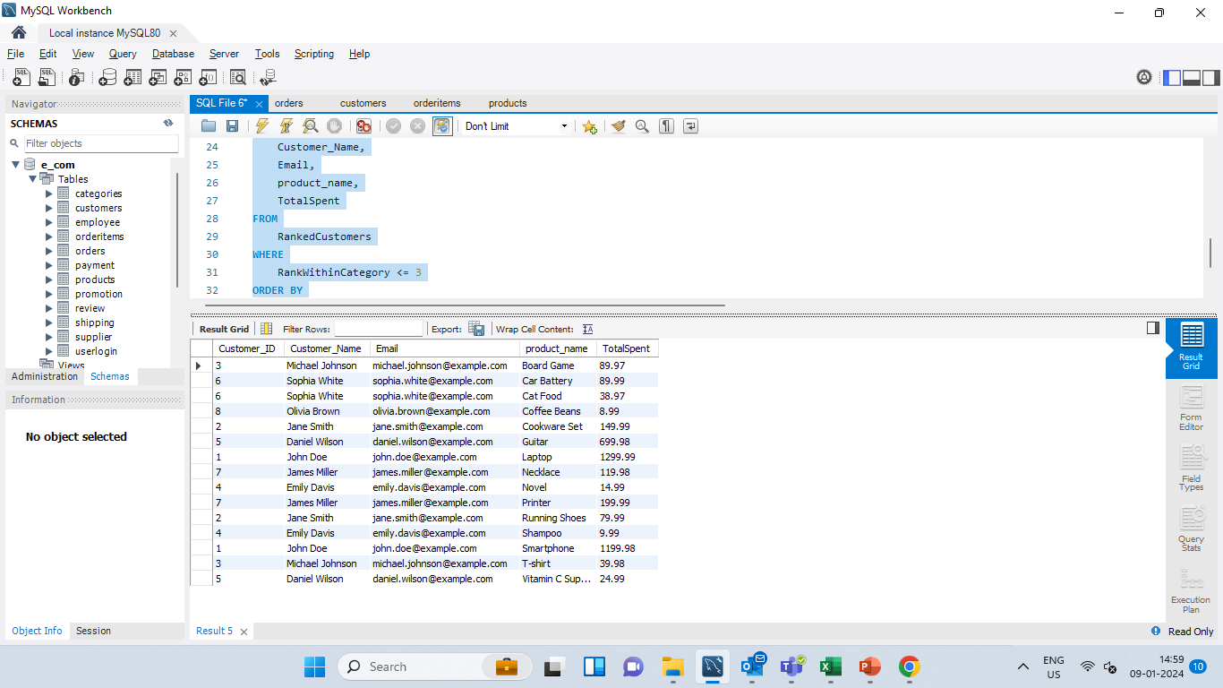
Write a query to find the top 3 customers who spent the most in each product category during the between '2023-01-01’ to '2023-01-20’ Include the customer's name, email, and the total amount spent.
QUESTION 7
OUTPUT

Slide 13

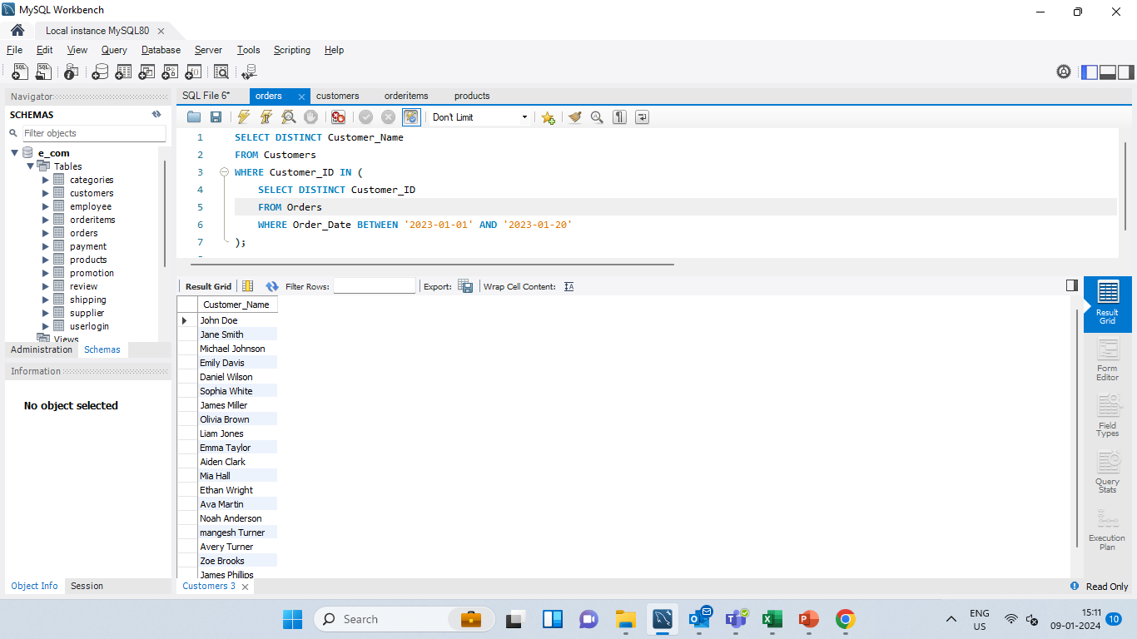
QUESTION 8
Retrieve the names of customers who have placed an order in the last 15 days. Display only unique customer names.
SELECT DISTINCT Customer_Name
FROM Customers
WHERE Customer_ID IN
(SELECT DISTINCT Customer_ID
FROM Orders
WHERE Order_Date BETWEEN '2023-01-01' AND '2023-01-20');

Slide 14
THANK YOU
Contact us at
Jigar Varak
jigarvarak2001@gmail.com

